Slide 1
File Management
Prepared By :
Nirali Borad

Slide 2
What is a File?
A file is a collection of related data that a computers treats as a single unit.
Computers store files to secondary storage so that the contents of files remain intact when a computer shuts down.
When a computer reads a file, it copies the file from the storage device to memory; when it writes to a file, it transfers data from memory to the storage device.
C uses a structure called FILE (defined in stdio.h) to store the attributes of a file.

Slide 3
Steps in Processing a File
Defining file or Create the stream via a pointer variable using the FILE structure:
FILE *p;
Open the file, associating the stream name with the file name: p = fopen(“filename”, “mode”);
Read or write the data to file using fgetc(p), fputc(c,p).
Close the file Using fclose(p).

Slide 4
The basic file operations / functions are
fopen() & fclose() - open a file- specify how its opened (read/write) and close an opened file.
fread & fwrite - read from a file & write to file.
fgetc() & fputc() - Read & write a character.
fputs() & fgets() - Read & write string.
fprintf() - write set of data values to file.
fscanf() - Read set of data values from a file.
fseek/fsetpos - move a file pointer to somewhere in a file.
ftell/fgetpos - tell you where the file pointer is located.

Slide 5
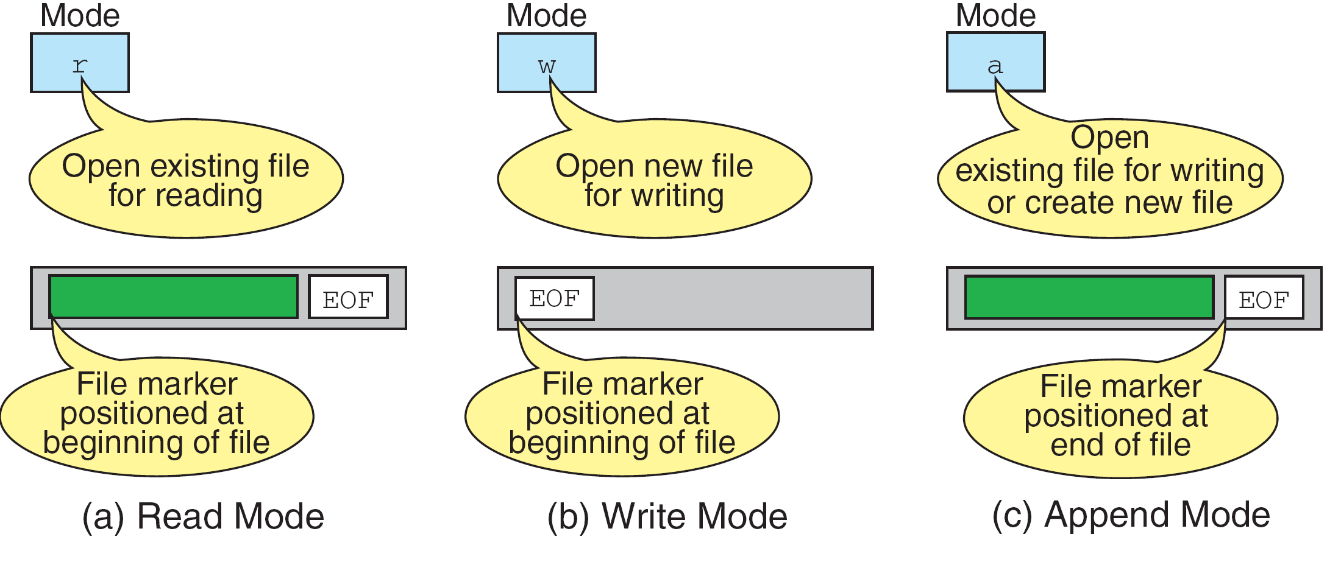
Mode string for fopen()

Slide 6
Additionally,
r+ - open an existing file for update (reading and writing).
w+ - Create new file for update, and if it already exist, it will overwritten.(reading & writing).
a+ - open for append; open for update at end of the file(reading and appending).

Slide 7
Defining file
File has name possibly with extension.
It is a string of character that make up a valid filename for os and compiler.
It is divided into 2 parts: name & extension.
File is defined as FILE in library of I/O function definition.
Syntax : FILE *fp ;
fp is pointer variable which can point to file.

Slide 8
Open file
The file open function (fopen) serves two purposes:
  It makes the connection between the physical file and the stream.
  It creates “a program file structure to store the information” C needs to process the file.
Syntax:
fp =fopen(“filename”, “mode”);

Slide 9
Continue…
The file mode tells C how the program will use the file.
The filename indicates the system name and location for the file.
We assign the return value of fopen to our pointer variable:
  spData = fopen(“MYFILE.TXT”, “w”);
  spData = fopen(“A:\\MYFILE.TXT”, “w”);

Slide 10
Read & write to file (fprintf())
Syntax:
fprintf (fp,"string",variables);
Example:
  int i = 12;
  float x = 2.356;
  char ch = 's';
  FILE *fp;
  fp=fopen(“out.txt”,”w”);
  fprintf (fp, "%d %f %c", i, x, ch);

Slide 11
fscanf()
Syntax:
fscanf (fp,"string",identifiers);
Example:
    FILE *fp;
    Fp=fopen(“input.txt”,”r”);
    int i;
    fscanf (fp,“%d",i);

Slide 12
fgetc()
Syntax:
identifier = fgetc (file pointer);
Example:
FILE *fp;
fp=fopen(“input.txt”,”r”);
char ch;
ch =fgetc (fp);

Slide 13
fputc()
write a single character to the output file, pointed to by fp.
Example:
FILE *fp;
char ch;
fputc (ch,fp);

Slide 14
Closing a File
When we finish with a mode, we need to close the file before ending the program or beginning another mode with that same file.
To close a file, we use fclose and the pointer variable.
fclose(spData);

Slide 15
Reading and Writing Files
#include <stdio.h>
int main ( )
{
FILE *outfile, *infile ;
int b = 5, f ;
float a = 13.72, c = 6.68, e, g ;
outfile = fopen ("testdata", "w") ;
fprintf (outfile, “ %f %d %f ", a, b, c) ;
fclose (outfile) ;
infile = fopen ("testdata", "r") ;
fscanf (infile,"%f %d %f", &e, &f, &g) ;
printf (“ %f %d %f \n ", a, b, c) ;
printf (“ %f %d %f \n ", e, f, g) ;
}

Slide 16
Example
#include <stdio.h>
#include<conio.h>
void main()
{
  char ch;
  FILE *fp;
  fp=fopen("out.txt","r");
  while(!feof(fp))
    {
    ch=getc(fp);
    printf("\n%c",ch);
    fclose(fp);
  }
  getch();
}

Slide 17
fseek()
This function sets the file pointer to a new position i.e., it is repositioned in a file.
  SEEK_SET Seeks from beginning of file
  SEEK_CUR Seeks from current position
  SEEK_END Seeks from end of file
Syntax :
fseek (FILE * stream, long offset, int whence)
First arguments is file pointer,
long offset is difference in bytes from the value mentioned in 3rd argument.
int whence can have value 0,1,2.
0 - beginning of file
1 – current position in file
2 – end of file.

Slide 18
Example
fseek(fp, -10, 1)
Here, last argument Is 1, it means from current position of pointer. So it will reposition file pointer 10 bytes in left side from current pointer position.
fseek(fp, 10, 0)
Here, last argument is 0, means from beginning of file. So it will reposition the file pointer 10 bytes in right side(forward) from beginning of file.

Slide 19
ftell()
offset = ftell( file pointer );
"ftell" returns the current position for input or output on the file
#include <stdio.h>
int main(void)
{
FILE *stream;
stream = fopen("MYFILE.TXT", "w");
fprintf(stream, "This is a test");
printf("The file pointer is at byte %ld\n", ftell(stream));
fclose(stream);
return 0;
}

Slide 20
Command-line arguments
Command-line arguments are parameters passed to a program when it runs from command prompt or invoked through programming environment such as Turbo-c.
Example : c:\tc\bin > file1 a.txt b.txt
file1-program name where code of program stored.
a.txt b.txt – arguments passed to program.

Slide 21
Continue..
Argument is also recognised into program by main() method.
Syntax : Void main(int argc, char *argv[])
argc is argument count & argv array stores passed arguments.
Example : argv[0] = file1
argv[1] = a.txt
argv[2] = b.txt

Slide 22
THANK YOU

